Slide 1
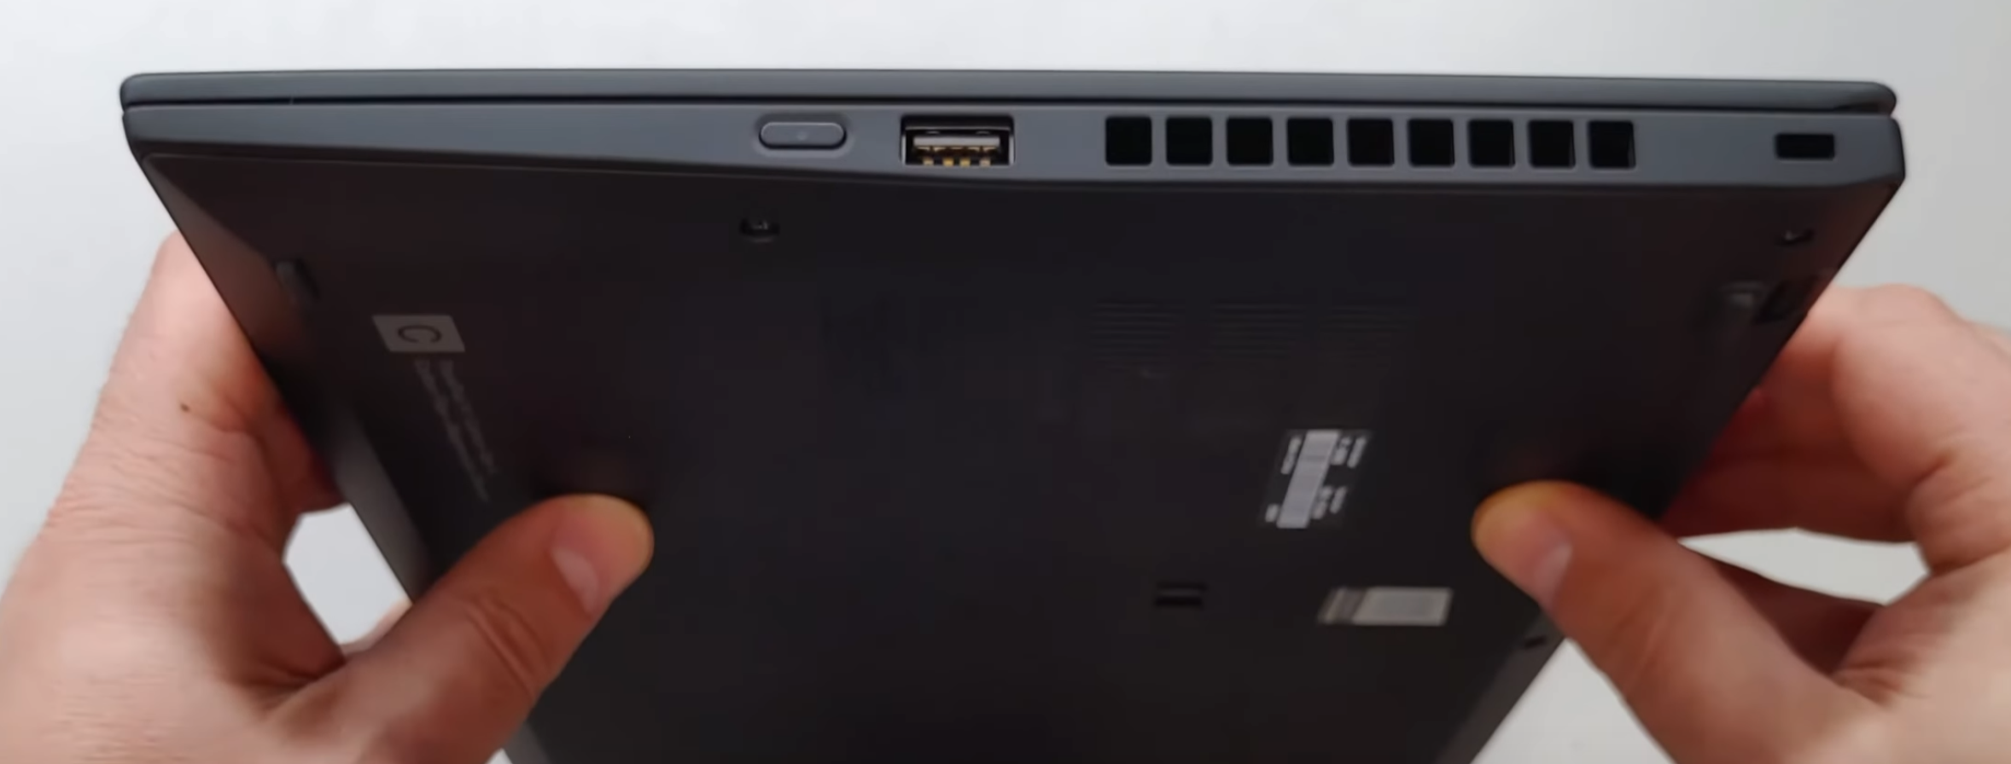
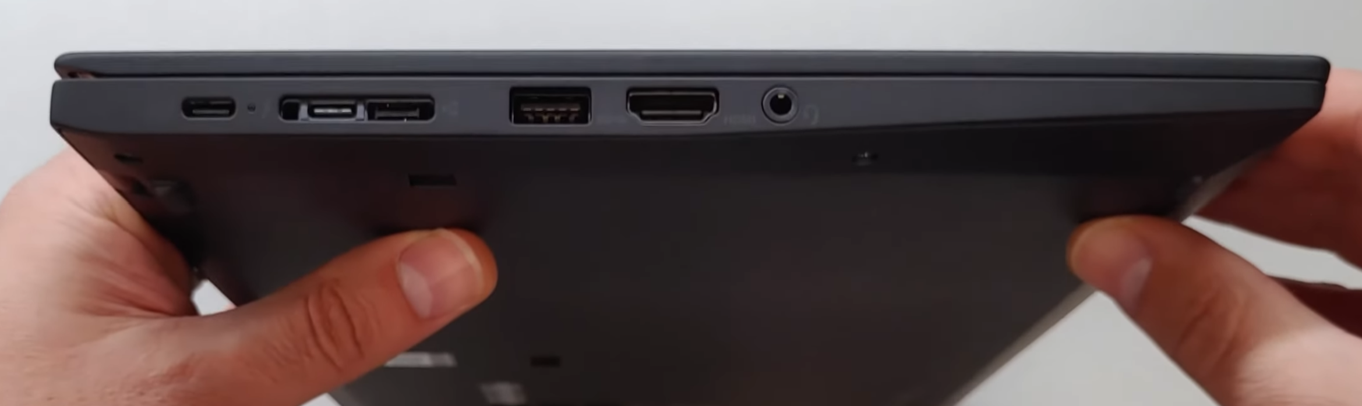
Teardown of a Lenovo X1 Carbon (8th Gen)
USB port and power button (I/O)
USB Port, Thunderbolt port, HDMI port, Headphone jack (I/O)

Slide 2
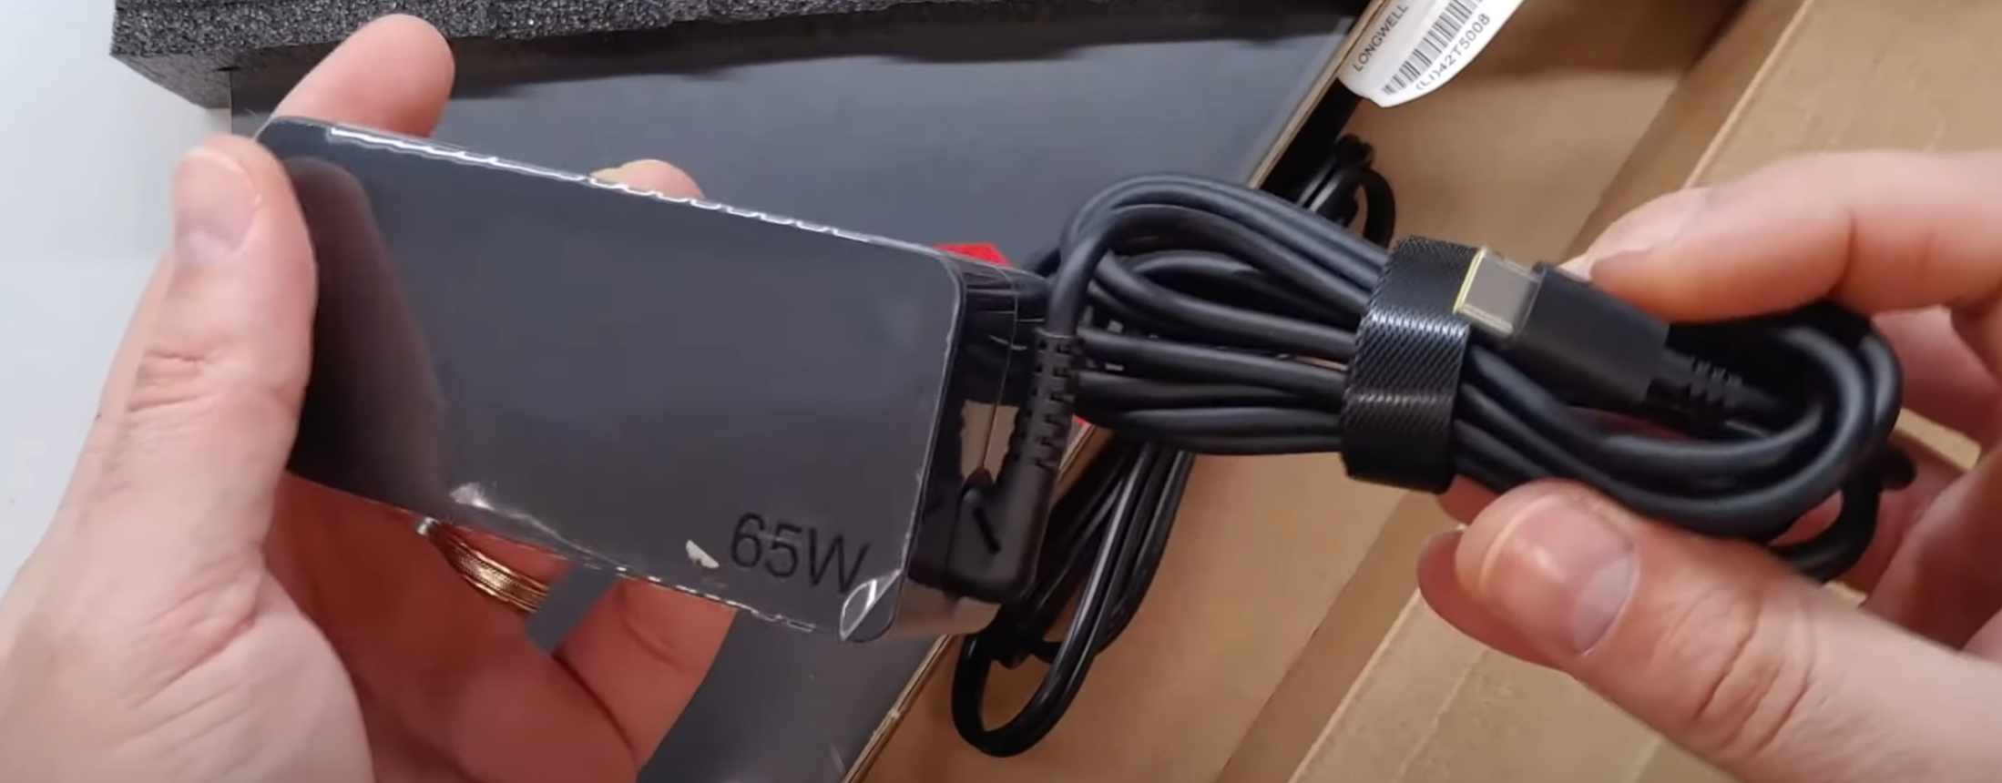
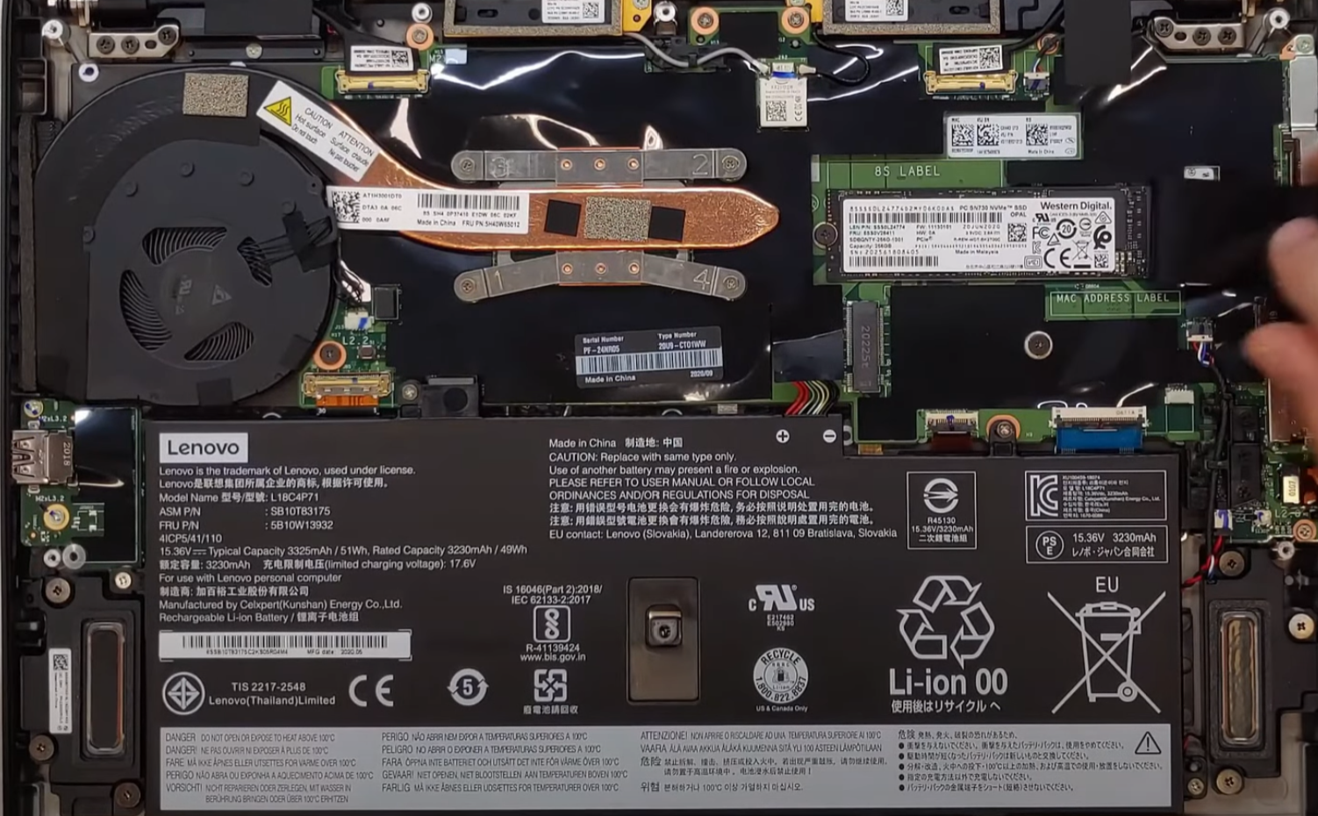
Teardown of a Lenovo X1 Carbon (8th Gen)
Power Supply
WiFi Card
SSD (Storage)
CPU (under heatsink)
Battery

Slide 3
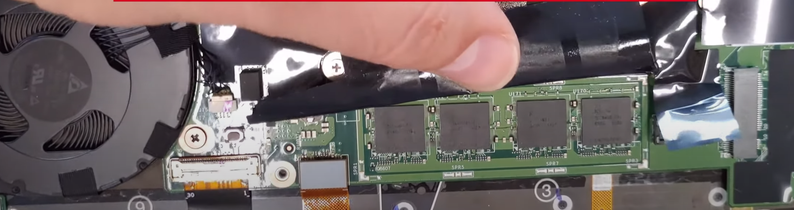
Teardown of a Lenovo X1 Carbon (8th Gen)
Memory
Note how tightly cramped all the components are, and how the construction is in layers. Makes the unit thin, light and compact, but makes upgrades and repairs more challenging. This unit even has soldered memory that the end user can’t replace. If you ever need more RAM, you need a new PC…
Motherboard (under Film)

Slide 4
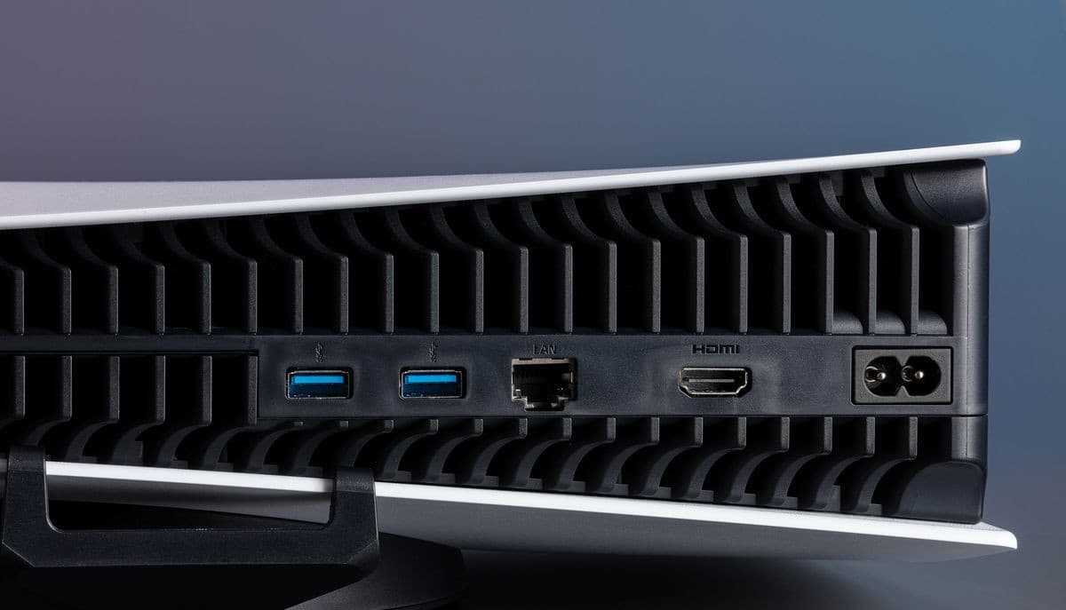
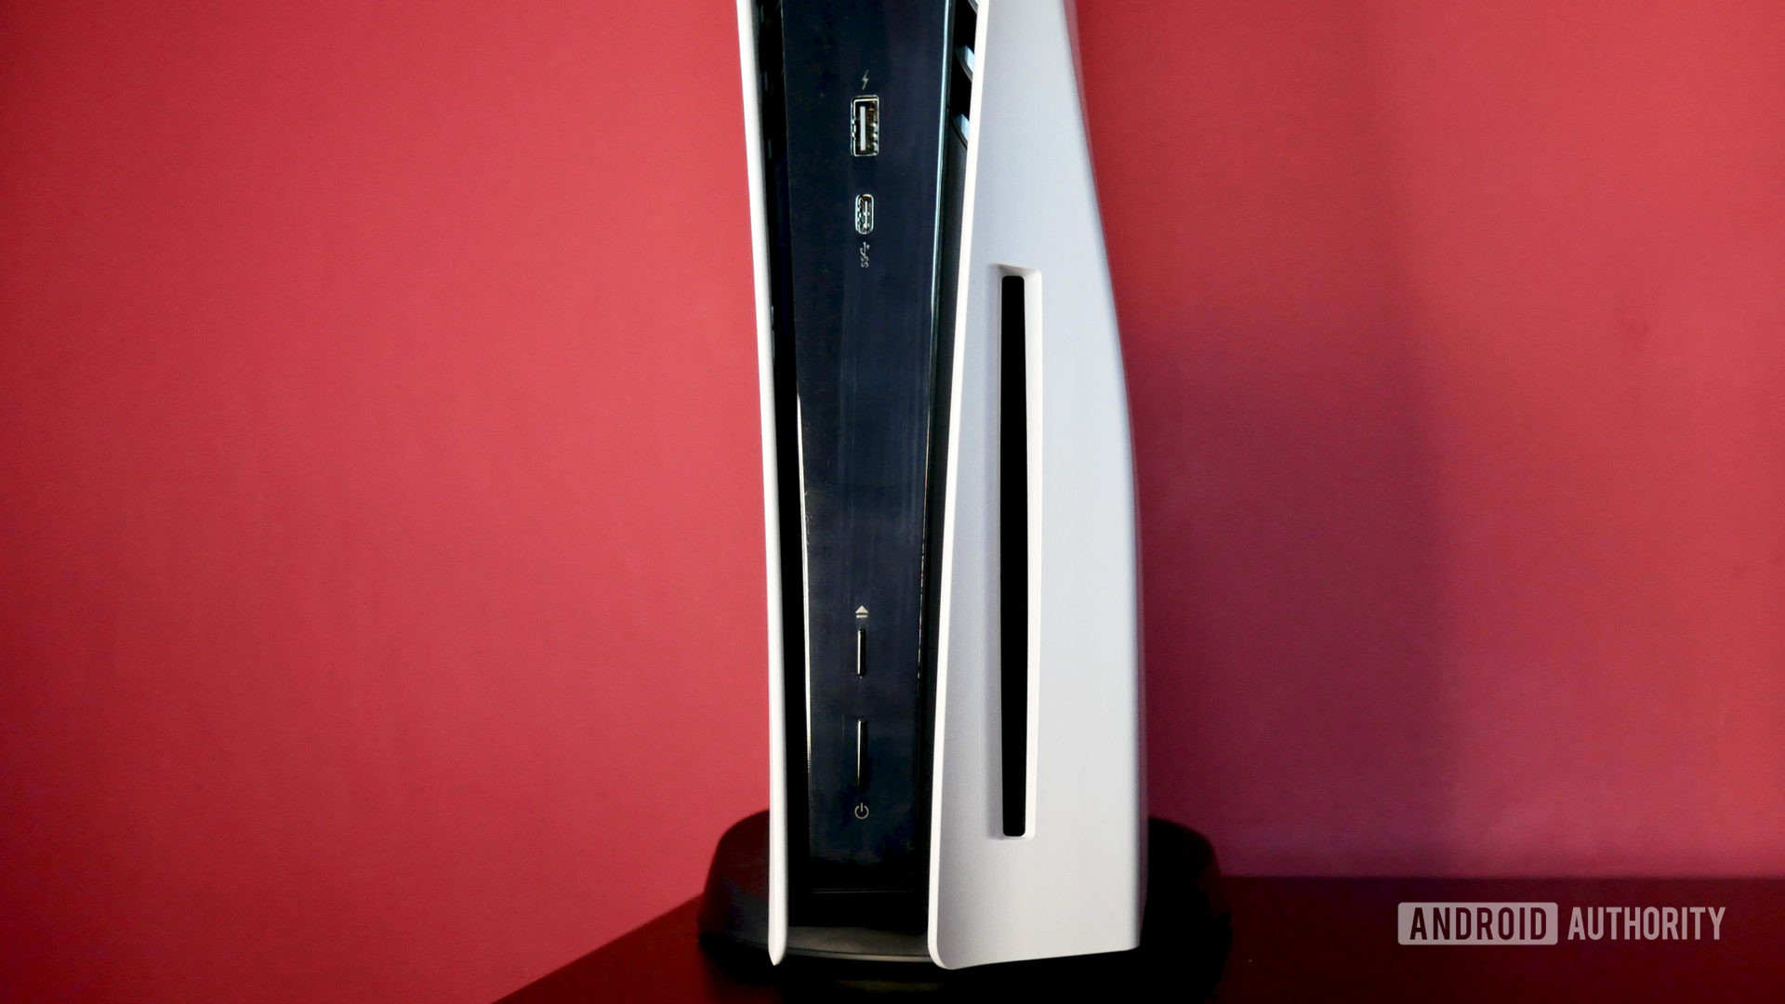
Teardown of a PlayStation 5
USB ports (Type A and C)
Disc Drive
USB Type A
HDMI Port
Power Chord input
Ethernet Jack

Slide 5
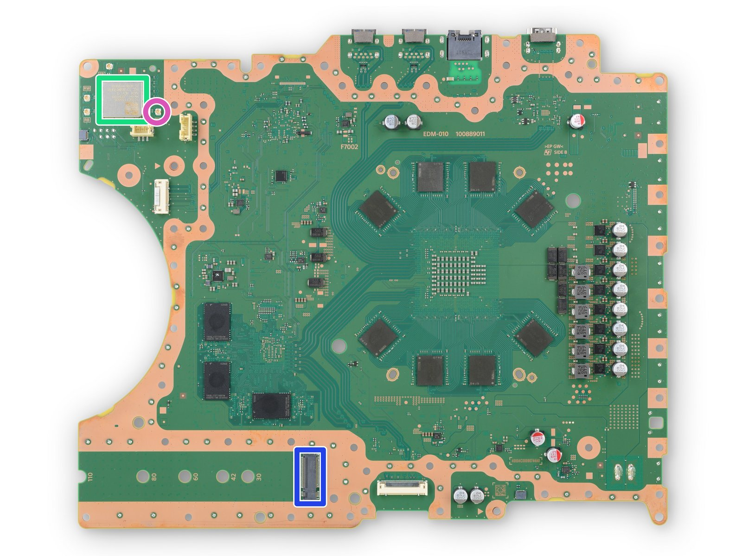
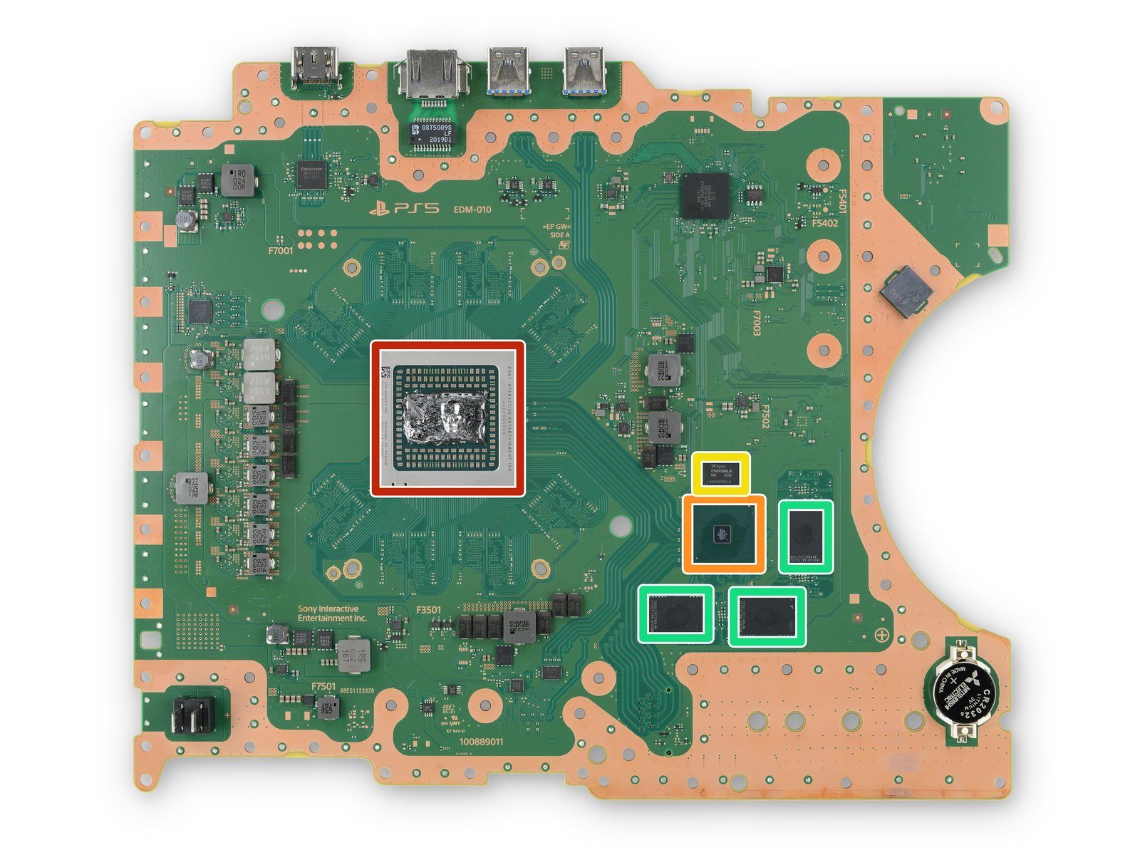
Teardown of a PlayStation 5
WiFi module
Motherboard
SSD (Storage)
CPU w/GPU
Memory
Memory
Storage Expansion Slot

Slide 6
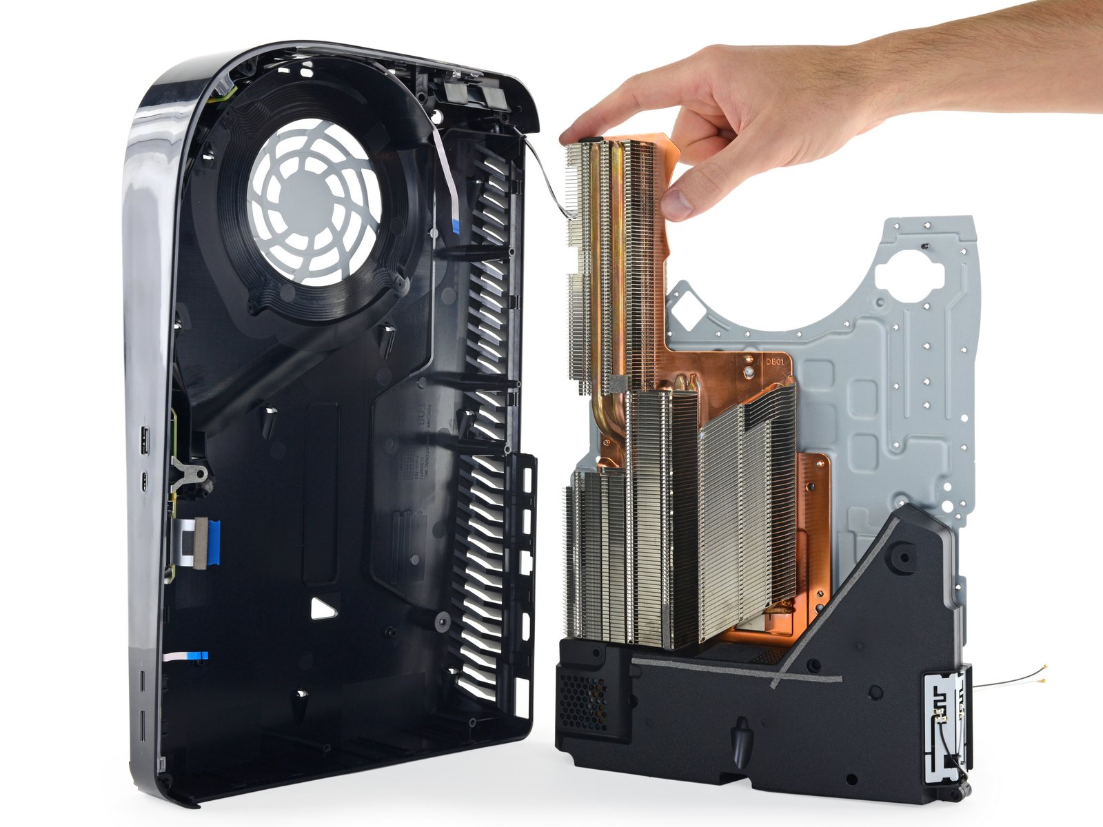
Teardown of a PlayStation 5
The vast space dedicated to cooling (large heatsink + large fan + numerous vents on the case) just speaks to the amount of heat generated by modern gaming consoles. Compare this to a business laptop that is arguably more useful but has far less exorbitant cooling measures. Perhaps this is a testament to how much heat a proper GPU generates.
Power Supply

Slide 7
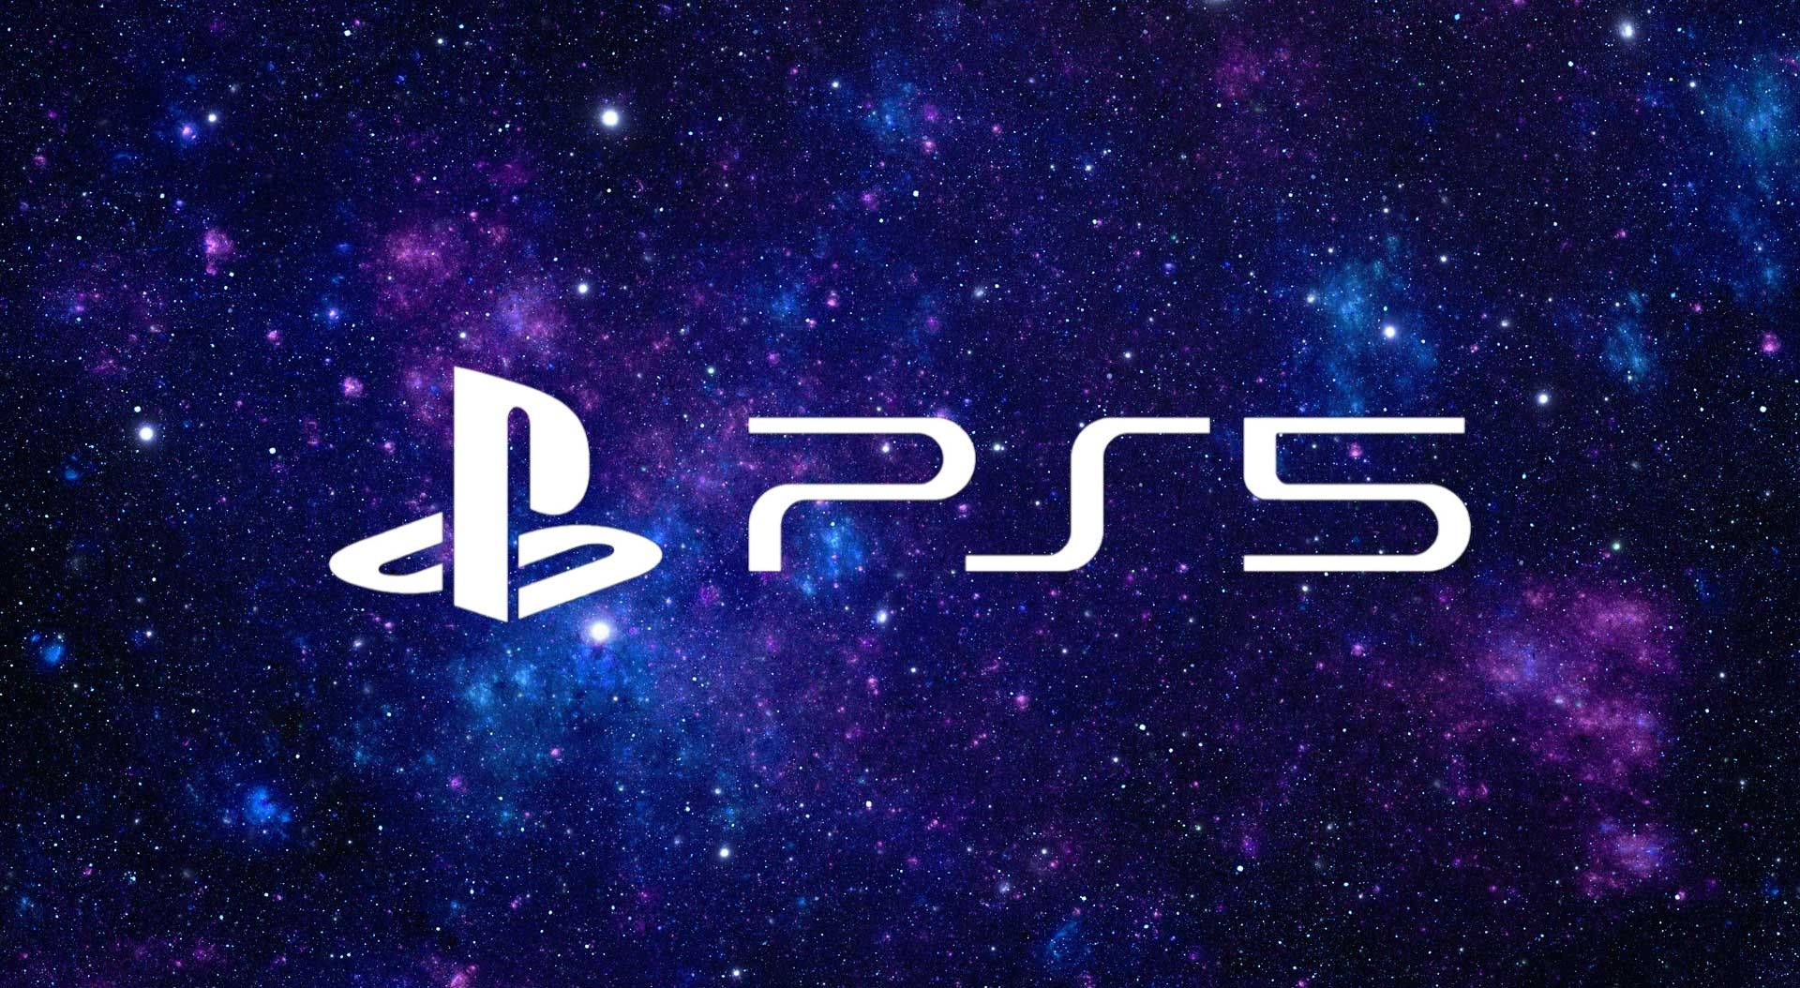

Reflection
The packaging of the laptop seemed to prioritize space and thinness, whereas the PS5 prioritized cooling. Part of this is likely due to the laptop needing to integrate a screen, keyboard, a battery, and more I/O.
Finding parts for the laptop wasn’t very hard, but the PS5 was more challenging. The vast amount of custom hardware that Sony created meant it looked like nothing else on the market, and I relied on diagrams and videos to make sure I had everything correct.
I picked the Lenovo laptop because…I use a Lenovo laptop, and I was curious what it looked like on the inside. I picked the PS5 because of the hardware. When first released in 2020, all of the tech reviewers were raving about the quality of the hardware, and the graphics capabilities. I wanted to see what made it all tick.
I was amazed by the amount of memory modules in the PS5. I thought it would be 1-2 sticks of ram like in a laptop or desktop, but it was many small modules, with several arranged radially. Perhaps this helped with cost to not have to develop new memory modules, or it allowed for better heat dissipation. I am unsure.

